Slide 1
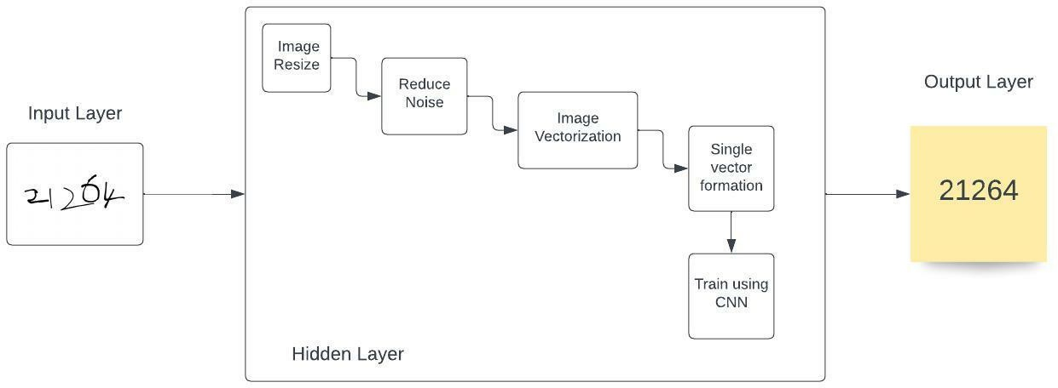
Project Design Phase-I Solution Architecture
Date | 01 October 2022
Team ID | PNT2022TMID45157
Project Name | Project – A Novel Method for Handwritten Digit Recognition System
Maximum Marks | 4 Marks
Solution Architecture:
A Novel Method for Handwritten Digit Recognition System

